Slide 1
Scaling Out HTC Workloads
Rachel Lombardi
OSGUS 23

Slide 2
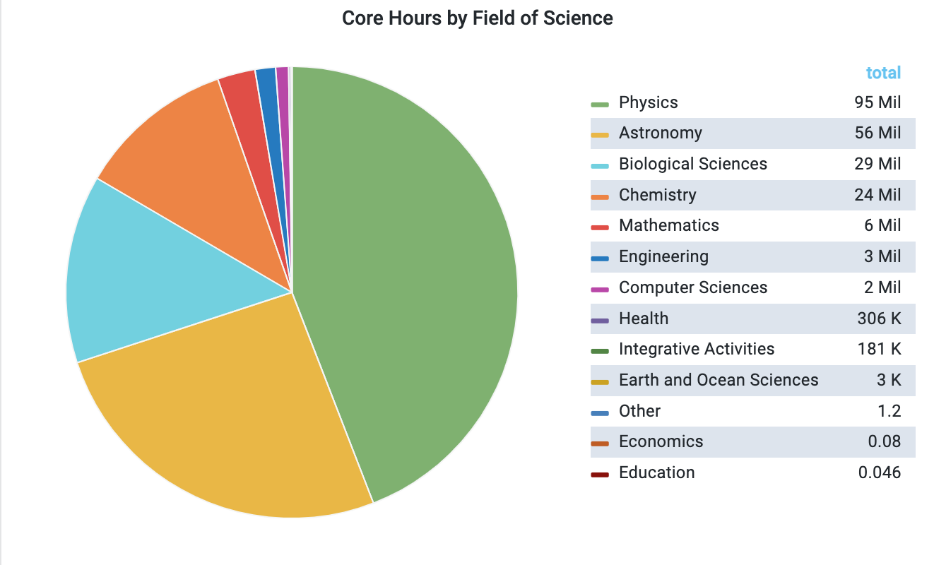
Agenda
Why scale out with HTC?
Steps for carrying out a HTC Workload
Assemble workload components
Organize workload components
Scaling Out
Job Attributes
Checking Completed Jobs
Summary

Slide 3
Why Scale Out with High Throughput Computing?

Slide 4


Why scale out with HTC?
Because we can Divide and Conquer to finish research faster, analyze more data, etc.
Basically, doing more
awesome research in less time!
Notes:
https://www.google.com/url?sa=i&url=https%3A%2F%2Fwww.timesnownews.com%2Fthe-buzz%2Farticle%2Fkerala-bakers-make-6-3-km-long-vanilla-cake-in-4-hours-in-thrissur-enter-guinness-world-records%2F541308&psig=AOvVaw2VbQAPne668Qehn2u_e244&ust=1691590526740000&source=images&cd=vfe&opi=89978449&ved=0CBIQjhxqFwoTCODK4vmfzYADFQAAAAAdAAAAABAI

Slide 5
HTC Workload Steps

Slide 6
Part 0 Assemble Workload Components

Slide 7
Recap: HTC Workload Components
What components do you need for an HTC workload (or single job)?
We have talked about all of these things this week!
Monday: HTCondor Job Submission
including coordinating input and output files
Tuesday: Software
Wednesday: Data

Slide 8

Reflection
What are the components you need for your HTC workload?
What results will you generate?
What other files will be generated by HTCondor or the jobs?

Slide 9
Part I Organizing HTC Workload Components

Slide 10
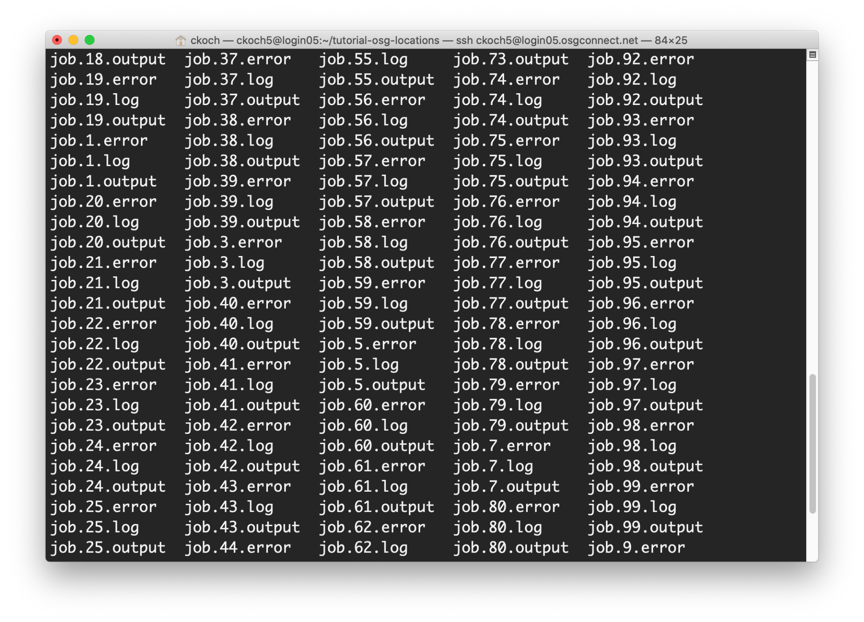
Why organize?
By default, HTCondor writes all job files (input, output, HTCondor logs, etc.) back to the same place, which means your home directory can look something like this:
This makes it hard to find things!

Slide 11
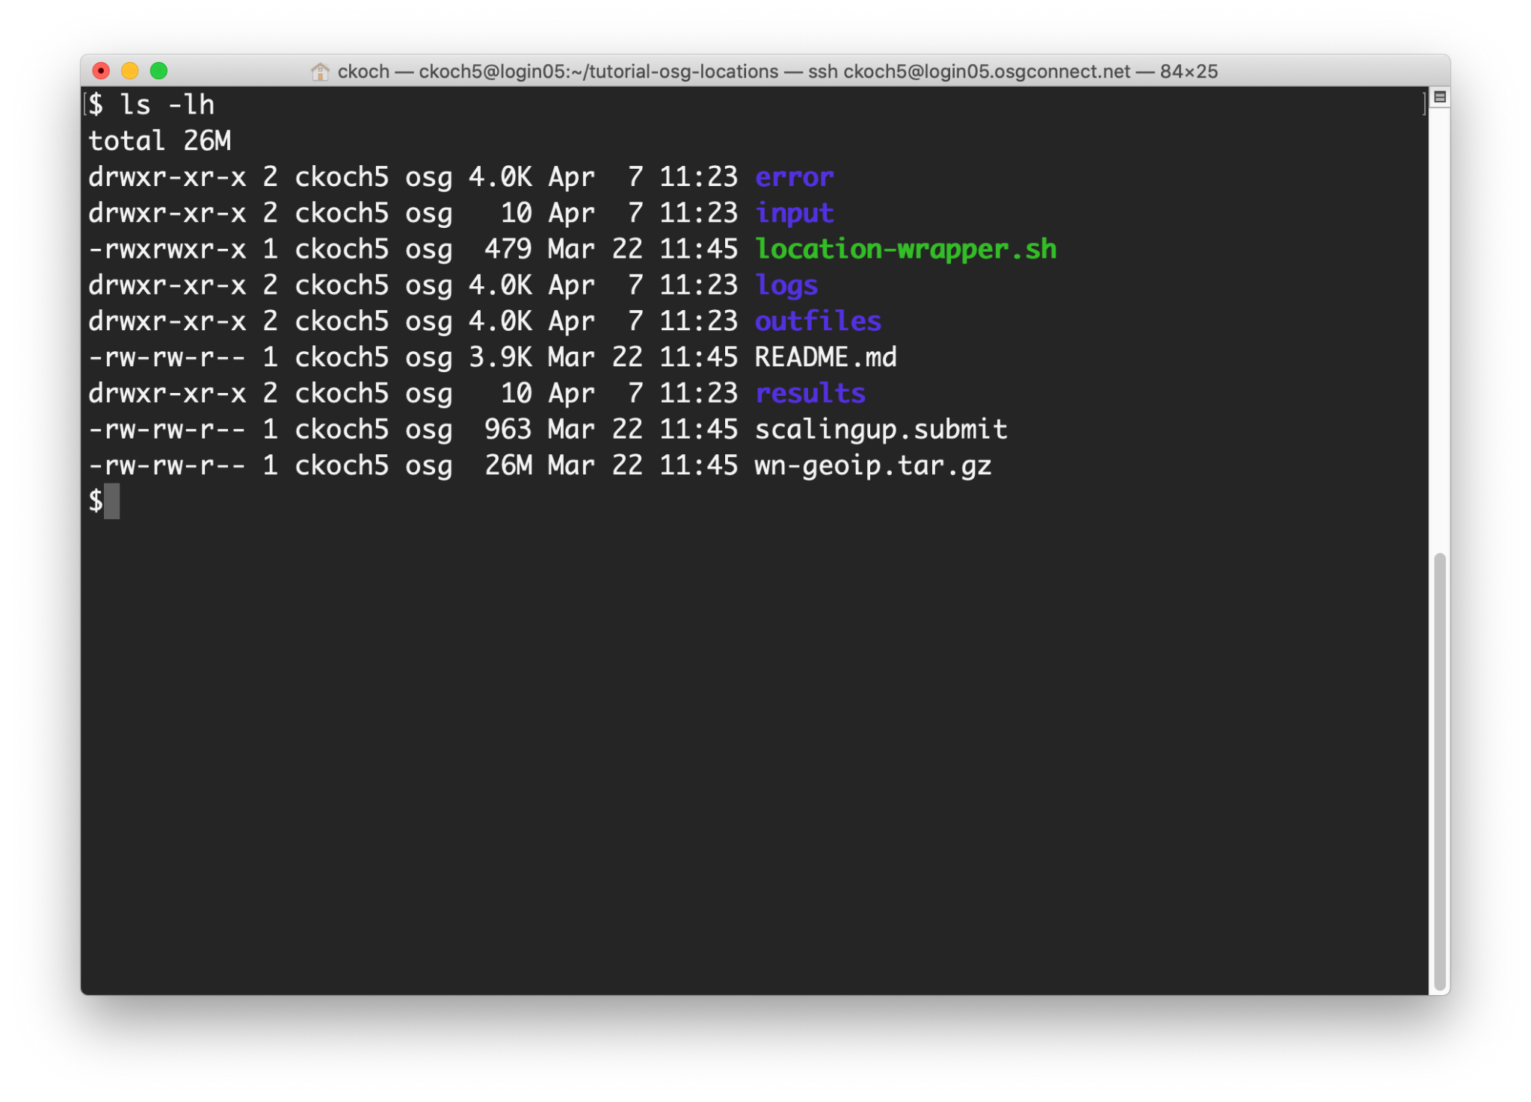
Why organize?
We can improve our workflow by intentionally organizing our input and output files on the Access Point.

Slide 12
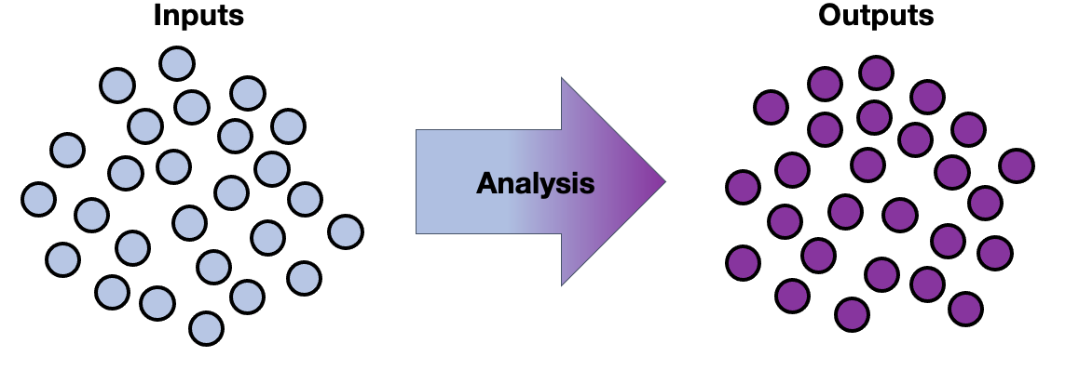
HTC Workloads as Input/Output Sets
The next example will model workloads that use many input files to produce many output files.

Slide 13
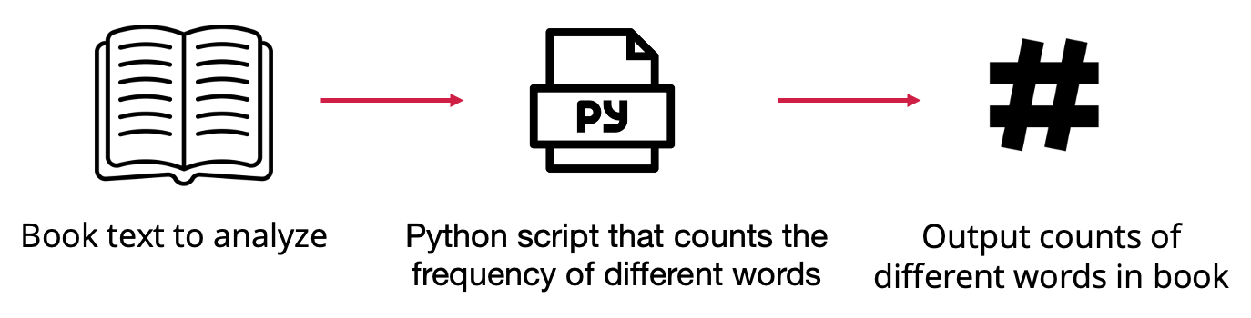

Example: Text Analysis

Slide 14
Organizational Plan For Our Files
wordcount.sub
wordcount.py
input/
Dracula.txt
...
output/
count.Dracula.txt
...
log/
job.0.log
...
errout/
job.0.out
job.0.err
...
We will assume that we want to put our input files (books) in one folder, and our output files (word counts) in another folder.

Slide 15
Organizational Plan For Our Files
wordcount.sub
wordcount.py
input/
Dracula.txt
...
output/
count.Dracula.txt
...
log/
job.0.log
...
errout/
job.0.out
job.0.err
...
There are additional files that will be produced by the job as well that we should consider – the HTCondor log, stdout and stderr. We’ll put these into two folders.

Slide 16
Coordinate HTCondor and File Structure
# submit file name: wordcount.submit
executable = wordcount.py
arguments = Dracula.txt
transfer_input_files = inputs/Dracula.txt
transfer_output_remaps = \
“count.Dracula.txt = outputs/count.Dracula.txt”
log = logs/$(ProcId).log
error = errout/$(ProcId).err
output = errout/$(ProcId).out
queue 1
wordcount.sub
wordcount.py
input/
Dracula.txt
...
output/
count.Dracula.txt
...
log/
job.0.log
...
errout/
job.0.out
job.0.err
...

Slide 17
HTCondor Options for Organizing Files
Syntax | Purpose | Features
Transfer_output_remaps = “file1.out=path/to/file1.out; file2.out=path/to/renamedFile2.out” | Used to save output files in a specific path and using a certain name | - Used to save output files to a specific folder - Used to rename output files to avoid writing over existing files
Initialdir = path/to/initialDirectory | Sets the submission directory for each job. When set, this is becomes the base path where output files will be saved. | - Used to submit multiple jobs from different directories - Used to avoid having to write some paths in other submit file values
More Information: https://htcondor.readthedocs.io/en/latest/users-manual/file-transfer.html

Slide 18
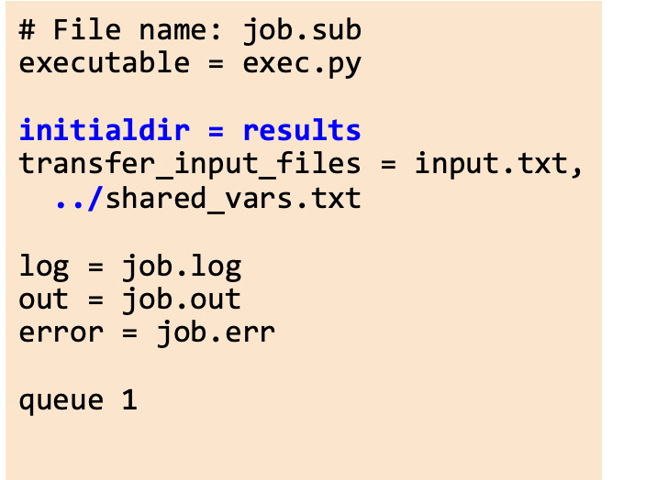
Return Output to Specified Directory with InitialDir
submission_dir/
job.sub
exec.py
shared_vars.txt
results/
input.txt
output.txt
job.err
job.log
job.out

Slide 19
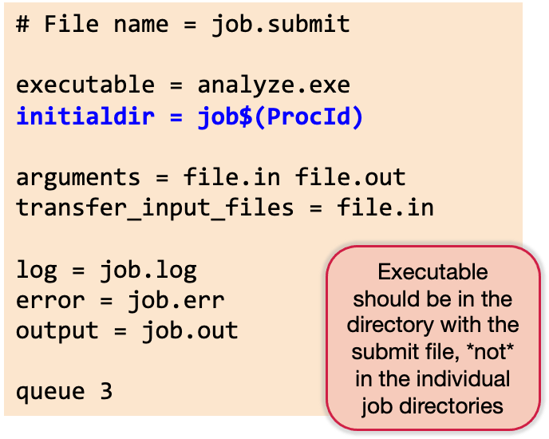
Separate Jobs with InitialDir
submission_dir/
job.submit
analyze.exe
job0/
file.in job.log job.err
file.out job.out
job1/
file.in job.log job.err
file.out job.out
job2/
file.in job.log job.err
file.out job.out

Slide 20
Organizing Data Files
Some HTC systems will have you place small files in one directory and larger files in a different directory.
For example, on ap40 (an OSPool Access Point), we place files less than 1GB in /home and larger files in an OSDF origin.
Once inputs and outputs are placed in the right location, use the appropriate HTCondor file transfer options to move the data to jobs.

Slide 21
Reflection
How big are the files in my input / output sets?
What organizational strategy makes sense for the next steps in my analysis?
Do you want inputs in one folder and outputs in another folder? Use transfer_output_remaps.
Do you have many outputs for each job that you’d like to group together, but keep separate from other job outputs? Do you want to keep inputs/outputs for the same job together? Maybe use initialdir.
How do you want to organize the HTCondor/system files?

Slide 22
Part II Scaling Out

Slide 23



Overview of the Scaling Out Process
Run a single job: For each job type, get a test job working reliably & tune resource needs
Test a small workload: Scale up to ~10 jobs, checking reliability & Access Point resource demand
Scale out: Continue scaling up in 10–100× increments, checking for & fixing issues

Slide 24
Stage 1: Get One Job Running
You know how to do this! 😊
Gather executable, inputs, arguments, etc.*
Estimate initial resource needs*
Write a submit file
Submit!
Review all outputs, including log, output, and error files
Check actual resource usage and update resource needs*
Repeat until (fairly) accurate and reliable
* More details on next slides

Slide 25
Stage 1: Tips for Initial Test Jobs
Test one of each kind of job you will run (e.g., prep, simulation, analysis)
Select smaller data sets or subsets of data for your first test jobs
Pick test jobs that will reproduce results from elsewhere, if possible
Name files carefully to help identify which results go with which tests
Make sure you understand and can run your software
Software — executable, dependencies, maybe a wrapper script to prepare environment
Command-line arguments
Input files

Slide 26
Stage 1: Estimating Initial Resource Needs
CPU
By default, start with 1
Unless you know for sure that you executable uses a certain number > 1
Memory
Start with the total memory available on laptop or where it ran before
It’s ok if this is a lot the first time, you will fine-tune later
Disk
Estimate (as best you can) and sum sizes of: executable (+ environment), input files, output files, temporary files, standard output/error

Slide 27
Stage 1: Run, Refine, Repeat
After running a test job:
Check logs and output for errors, warning, holds, etc.
Check HTCondor job log for actual resource usage
Fix issues, update resource needs, run 1 job again!
Good opportunity to check “fit” of jobs to HTC and maybe adjust
005 (1234.000.000) 2022-07-28 09:12:34 Job terminated.
(1) Normal termination (return value 0)
[...]
Partitionable Resources : Usage Request Allocated
Cpus : 1 1
Disk (KB) : 40 30 4203309
Memory (MB) : 1 1 1

Slide 28
Stage 2: Scale To About 10 Jobs
For each kind of job, once you have 1 job working, try about 10
Try a representative variety of arguments and input files
Start developing methods for checking results of all jobs
Estimate total resource needs for the Access Point itself
Repeat tests at this scale until issues are fixed & resources are accurate

Slide 29
Stage 2: Try Various Inputs
For Stage 1, the suggestion was to keep things short and simple
For Stage 2, it is time to explore the entire range of inputs to your jobs
Different command-line arguments; e.g., start, middle, and end of parameter sweep
Different input files; e.g., small, medium, and large — whatever makes sense for you
As you explore, you may find that per-job resource needs vary
Set your resource requests a bit higher than maximum observed usage
For example, if 10 test jobs used between 938 MB – 1.23 GB of memory, update your submit file to request 1.5 GB memory
After any changes, run the same test again and re-evaluate

Slide 30
Stage 2: Checking Results of Multiple Jobs
Start developing methods for checking the results of multiple jobs
Output from your executable (i.e., your research results)
Debugging output: standard output and error files, executable logs, etc.
HTCondor job log file (log = job.log in your submit file)
This may be one of the most overlooked aspects of scaling up!
Checking 1 job is easy; checking 10 is tedious; checking 1000s by hand? 😭
Techniques include:
Sampling
Developing tools to automate (see Part III)
Sounds a bit like research, right? You know how to do that…

Slide 31
Stage 2: Estimate Access Point Needs
Do not forget about your Access Point – it is a shared resource, too!
Storage space for files
Based on a run of 10 jobs, estimate total number and size of all files for full production
Do you have enough storage space on the Access Point? If not, what options exist?
Number of running jobs
In theory, how many jobs could you have running at once?
Each running job uses some CPU and memory on the Access Point itself
If submitting over 10,000 jobs consider limiting (throttling) running and idle jobs on Access Point

Slide 32
Stage 3: Iterate in Steps of 10–100×
By now, you have tested tens of jobs, maybe in a workflow; what next?
Continue scaling up in increments of 10–100 times the number of jobs
All the considerations from Stage 2 apply at each increment
Be sure to find, understand, and hopefully fix issues before moving on
As you scale up, a challenge is to distinguish among:
Real issues with your jobs, workflow, resource requests, etc.
Real issues with certain subsets of your jobs
Temporary issues with the HTC infrastructure itself
Bugs and other longer-lasting issues with the infrastructure
We can help! Email us with support requests if you get stuck.

Slide 33
Reflection
Where are you in the scaling up process?
What are three things you should consider in your current stage?

Slide 34
Part III Tools for Monitoring

Slide 35
Tools for Learning About Jobs
HTCondor’s job attribute information
Accessed via condor_q, or condor_history
Files
HTCondor log files
Standard error/standard output files

Slide 36
Job Attributes

Slide 37
Job Attributes with condor_q
HTCondor stores a list of information about each job.
This information is stored in this format:
AttributeName = value
You can find a list of attributes for a single job by running:
condor_q -l JobID
You can print out specific attributes by using the “format” or “auto-format” flags with an HTCondor command:
condor_q -af Attribute1 Attribute2
adds job number: condor_q -af:j Attribute1 Attribute2

Slide 38
Interesting Job Attributes
Job identifying information
ClusterID
ProcID
Cmd
Arguments
UserLog
Where it ran
LastRemoteHost
MATCH_EXP_JOBGLIDEIN_ResourceName
Resource Request and Usage
RequestCpus (Memory, Disk)
MemoryProvisioned (Disk)
CPUsUsage (MemoryDisk)
Timing
EnteredCurrentStatus
QDate

Slide 39
Interesting Job Attributes
Codes
JobStatus
ExitCode
HoldReasonCode
HoldReasonSubCode,
NumHoldsByReason
Counts
NumJobStarts
NumShadowStarts
NumSystemHolds,

Slide 40
Checking Completed Jobs

Slide 41
Checking Completed Jobs
condor_history
Contains finalized job attributes for completed jobs
some have different names (HoldReason --> LastHoldReason)
Easy to use constrain and to display values (like condor_q)
Can be slow to search (latest first) and may drop old records quickly
HTCondor job log files (log = job.log in submit)
Contain a lot of information
That is both a blessing and a curse
Somewhat easy to parse — or use HTCondor Python bindings/other tools to help

Slide 42
HTCondor Job Log Files
One big, combined file, or one per job? Your preference, really
With tens or hundreds of jobs (& more), not practical to review manually
Can try to use the grep command-line tool to find specific lines
Use a tool to summarize log results (logs2csv)

Slide 43
HTCondor Job Log Files: Terminations
To find when every job ended:
$ grep '^005' LOGS
(LOGS can be one file, a list of files, or a glob (using *) of files)
To find termination codes (exit codes) for every job:
$ grep termination LOGS
(will not show job IDs, though)
To get counts by termination code:
$ grep termination LOGS | sort | uniq -c

Slide 44
HTCondor Job Log Files: Resource Lines
To get memory resource lines:
$ grep -h 'Memory (MB) *:' LOGS > memory_resources.txt
To get disk resource lines:
$ grep -h 'Disk (KB) *:' LOGS > disk_resources.txt
Import the resulting files into Excel (with some attention to import options)
For file transfers:
$ grep -h 'Total Bytes Sent By Job' LOGS
$ grep -h 'Total Bytes Received By Job' LOGS

Slide 45
HTCondor Job Log Files: Checking on Holds
To view all job holds, their reasons, and related codes:
$ grep -h -A 2 '^012' LOGS
(Omit the -h option to see log filenames for each hit.)
Note: The OSPool may automatically release (rerun) some held jobs; if you don’t look for them explicitly, you may never know those holds occurred

Slide 46
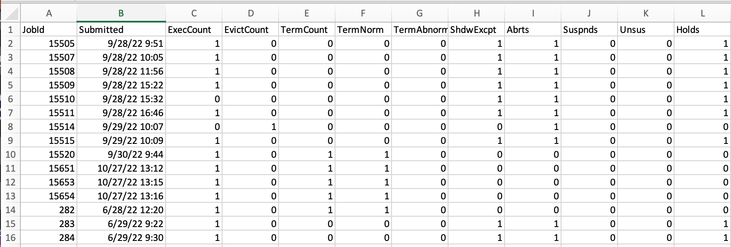
HTCSS Job Event Log to CSV Summarizer
A simple script that reads HTCondor job event logs and outputs a CSV summary of job statistics.
[alice@ap40 logs]$ logs2csv *.log > summary.csv
https://github.com/osg-htc/job-event-log-to-csv

Slide 47
In Summary How to be a Responsible HTC Researcher

Slide 48

How to be a Responsible HTC Researcher
Notes:
Is your code correct?
Assess resource requests – too much? Not enough?

Slide 49
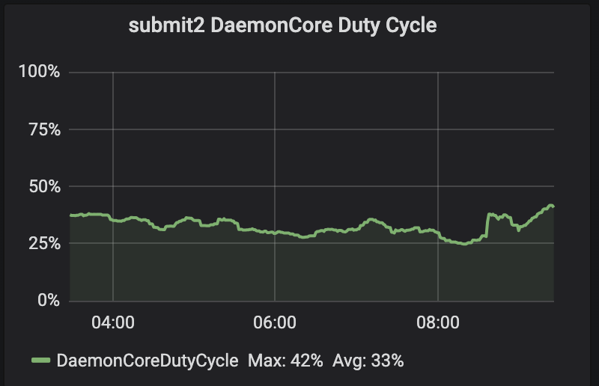
Responsible HTC Researchers
In General
Stable user experience!
Can easily log in, jobs can have fewer access point related issues, etc.
Allows you and other researchers to carry out your work with little interruption
Makes IT staff happy!
Allows them to focus more on things such as deploying new features, system upgrades, etc.
Stable
Daemon core duty cycle is a representation of how "busy" the scheduler is with all its responsibilities.
Notes:
Daemon core duty cycle is a representation of how "busy" the scheduler is with all of its responsibilities. One you get close to 100%, you start to notice slowness in all elements of the scheduler.
9:48
The reason for that is, below 100% means there's spare "time" in the cycle.Essentially, it's like at a day job if you finish all of your tasks before the day is over... then you wait for more. Once you're above 100%, tasks from monday start spilling into overtime or into tuesday.

Slide 50
Every once in a while, we have troublesome HTCondor jobs …

Slide 51


Slide 52
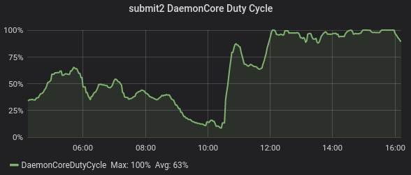
Troublesome HTCondor Jobs
Here, the CHTC scheduler was at 100% capacity and started to lag behind on work.

Slide 53
Troublesome Jobs
Repeatedly having jobs go on hold due to insufficient resource requests, code errors, etc.
Wastes computing resources
Decreases your user priority without good research being done
Transferring data inappropriately, running very short jobs (~seconds), etc. can cause:
Access Point to slow down and prevent you/other users form logging in
Can take HTCondor commands take longer to respond, increasing the time it takes to submit, manage, and check on jobs

Slide 54

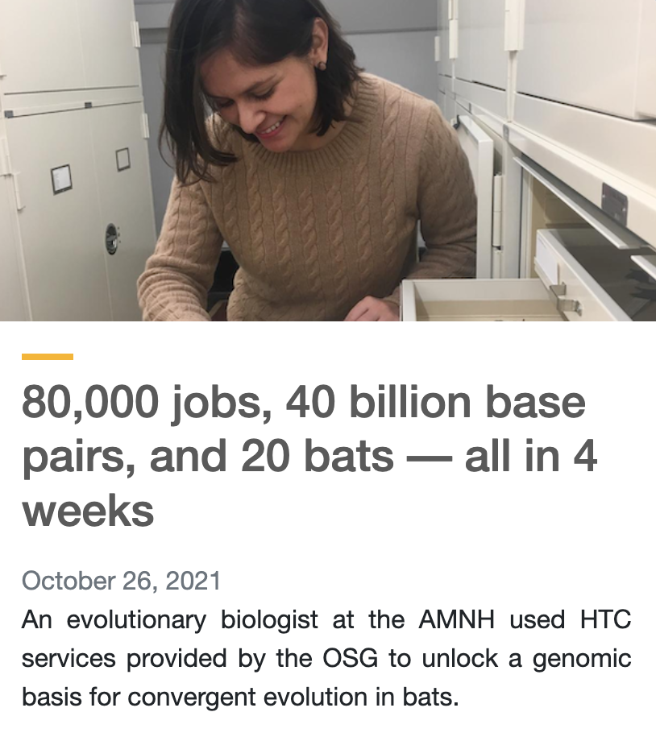

Don’t be afraid to think big with your computing!
HTCondor systems are designed to efficiently manage many jobs and we are here to support you to use computing resources to do novel research.
But be conscious of your code, job structure, and of the staff helping you
complete your research.

Slide 55

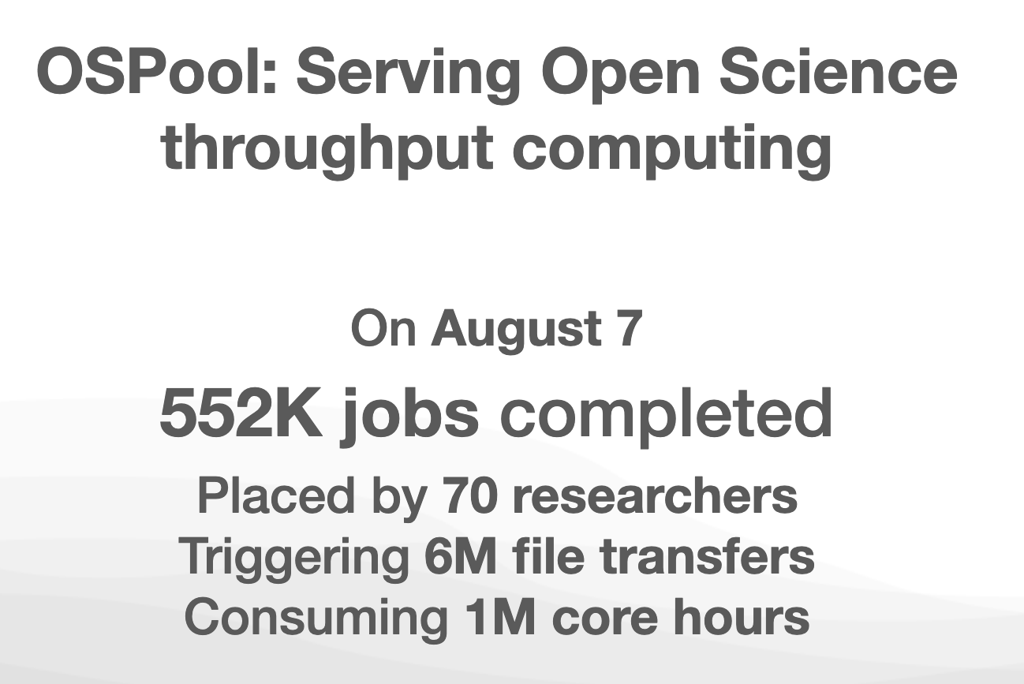

Questions?

Slide 56
Additional Slides of Interest

Slide 57
Other Thoughts: What’s Your Context?
Major considerations (details vary a lot!):
Computational workflow: Automate running of different jobs in order
Technical workflow: Management of runs, files, etc.
Research workflow: Revisit goals, scale, and how computing fits

Slide 58
Other Thoughts: Computational Workflows
Do you have different kinds of jobs that need to be run in a specific order to implement your overall computational goal?
If so, you may be able to use HTCondor DAGMan (or other tools) to automate parts or all of the whole process.
Attend the optional DAGMan lecture later today if you think this situation applies to you!
Test computational workflows with few jobs of each type, just as you would in Stage 2.

Slide 59
Other Thoughts: Technical Workflow Considerations
How will you get the necessary files to the Access Point and, if needed, OSDF Origin?
How will you manage individual sets of runs? For example, how will you organize files (see earlier)? If you need to rerun jobs, how will you keep track of each run?
How will you move results off of the Access Point (which is temporary storage only)? Do you have a place to archive results? How will it be organized?

Slide 60
Other Thoughts: Research Workflow Considerations
Now that you have run some jobs:
Consider the balance between human effort (yours!) and computer time; will the use of HTC actually save you time in the long run and improve your research?
Estimate how much total calendar time it will take your computational work to complete. Do you have enough time before your next deadline?
Could you do even more? If things are going well, could you expand your research questions by using more computing? Think big!

